Slide 1
Comparing neighbourhoods in London
Capstone Coursera Python Project using Foursquare data on Neighbourhoods

Slide 2
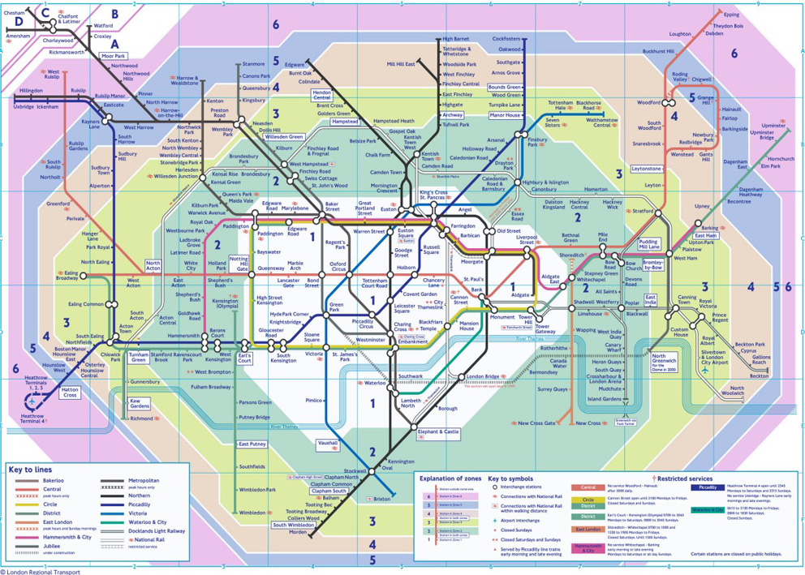
Project description
London is my new home and the project will be comparing 4 neighbourhoods
To give you an idea of the overwhelming feeling I had, below you will see an image of the London Tube maps and zones.
The 4 areas are: Mayfair, Chancery Lane, Putney and Hammersmith.

Slide 3
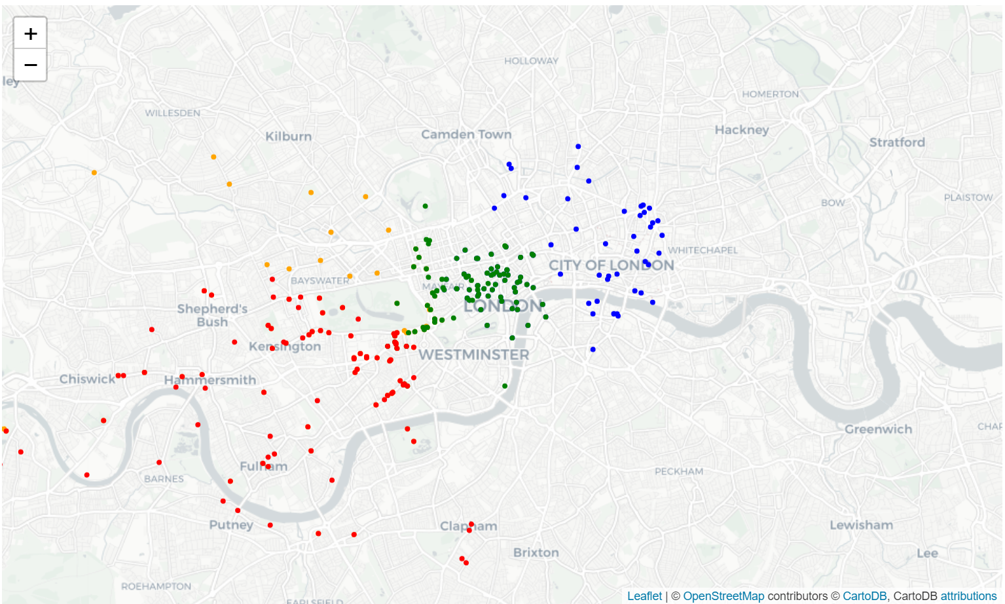
Foursquare data
For each of the 4 areas, the 100 closest venues were extracted using Foursquare data.
Chancery Lane, Mayfair, Putney and Hammersmith foursquare points are seen below:

Slide 4
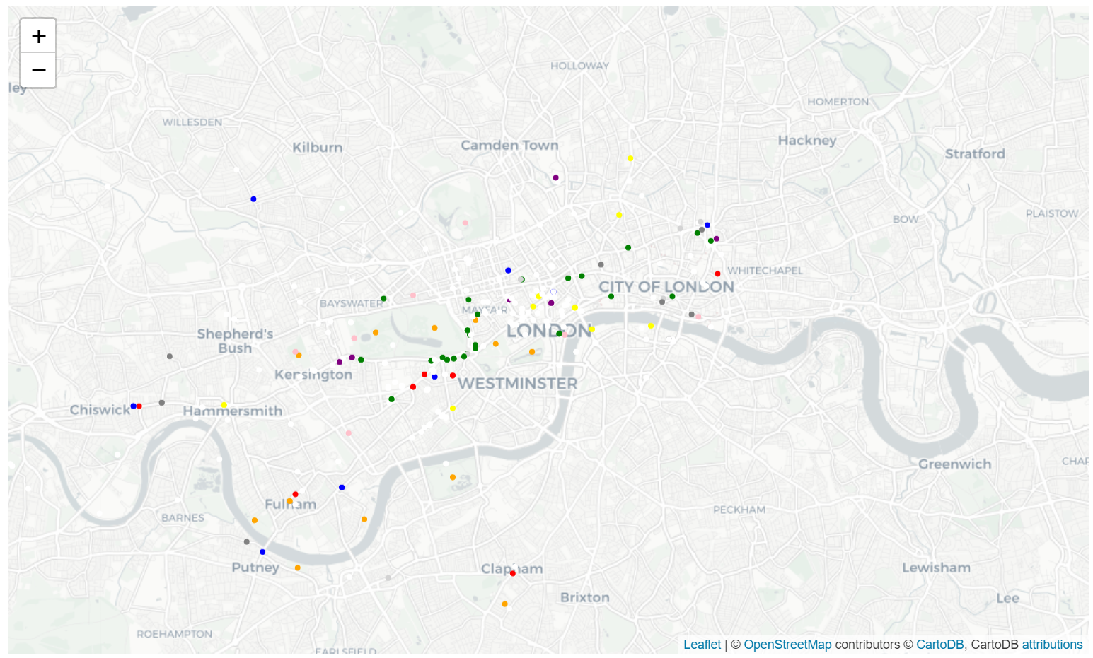
The most common venues
The data showed that the following venues were most common:

Slide 5
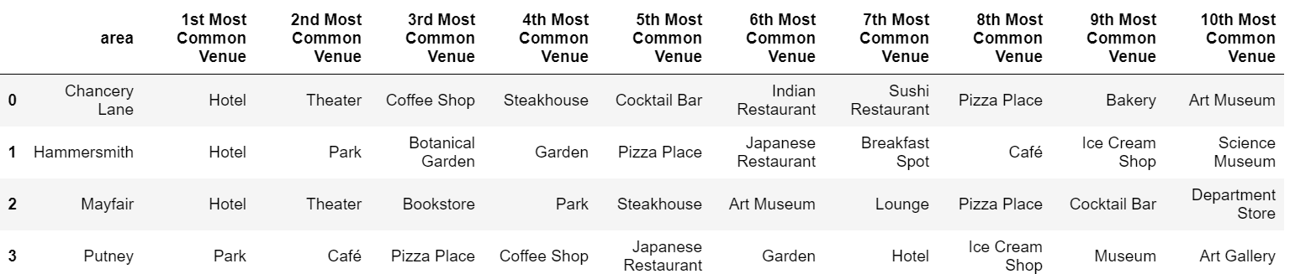
Most common venues for each area
Chancery Lane, Hammersmith and Mayfair all have Hotels as the number 1 most common venue, but Putney only has this as the 7th most common venue.
Here we can already see that Putney is not too similar to the other neighbourhoods.
Hammersmith and Putney seem to have Parks quite high up on common venues, so this could be giving an indication of them being similar.

Slide 6
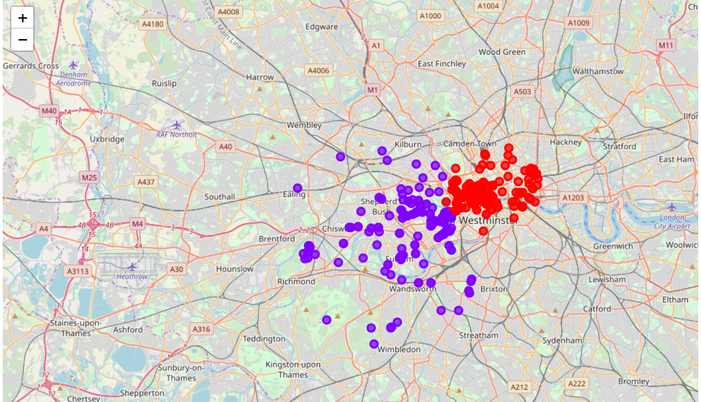
Methodology – Running k-means
It was decided to use 2 clusters for k-means to see which of the 4 neighbourhoods are more similar. The k-means test was done by dividing each of the neighbourhoods into the venues that are most common in the area.
Results from the k-means test showed that Chancery Lane and Mayfair are clustered together and that Putney and Hammersmith are clustered together.
This was an early suspicion as the similar venues for each cluster as well as the physical location of the two clusters had clear differences.

Slide 7
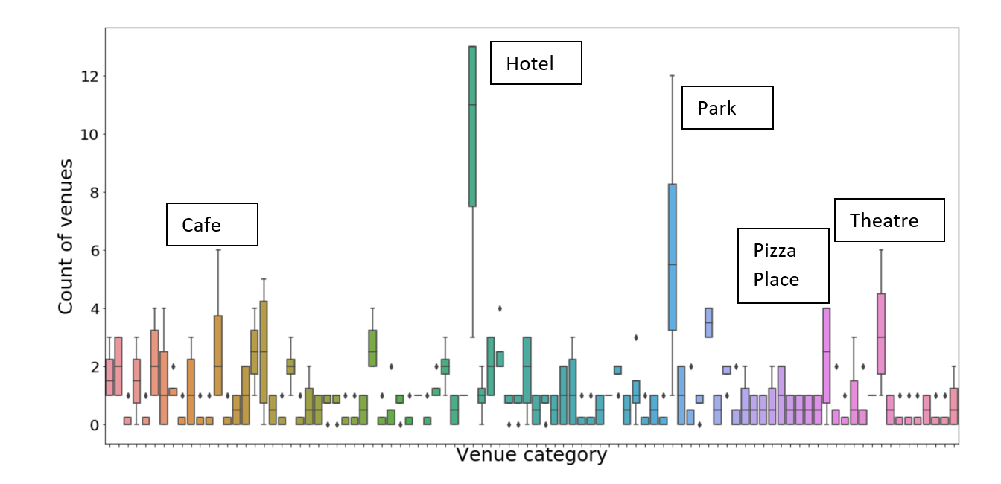
Additional investigations
Some box plots had confirmed some results. Hotels, Parks, Pizza Places, Theatres and Cafes were by far the most common venues.

Slide 8
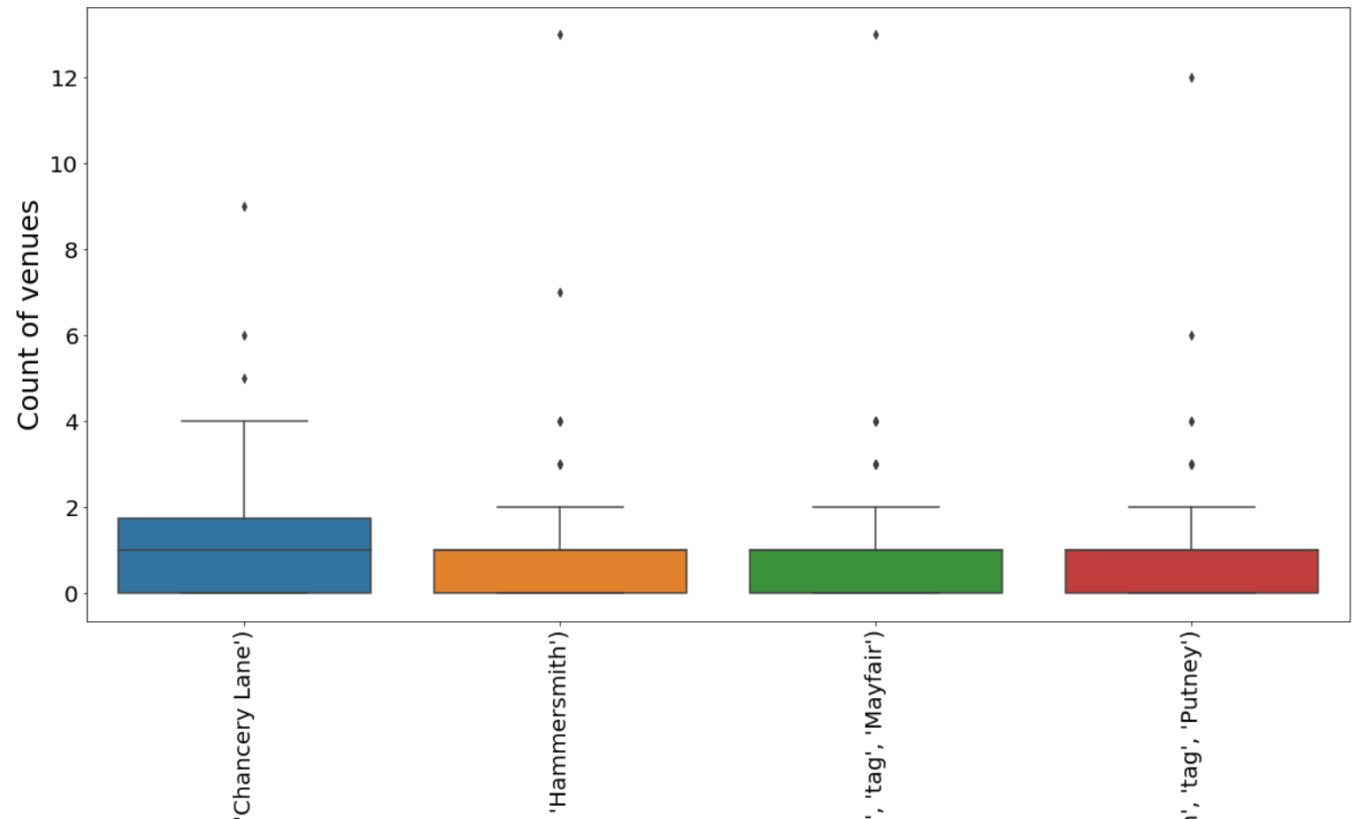
Additional Investigations (cont.)
Though the 4 venues did indeed cluster into 2 parts, looking at overall totals number of venues in each area irrespective of which venue it is, the 4 venues were in fact very similar.

Slide 9
Results
MAPS:
Chancery Lane and Mayfair are zone 1 and more central.
Hammersmith and Putney are zones 2 and 3 respectively and are more west out of central London.
The maps showed that the zone 1 neighbourhoods had venues more closely situated to the points of interest. The other two neighbourhoods had venues that were more spaced out.
We also saw that Hotels, Parks and Pizza places are the most common venues over all 4 neighbourhoods.
K-MEANS:
The preparation for k-means showed us the most common venues for each of the neighbourhoods.
The two zone 1 neighbourhoods were clustered together, having similar venues.
BOX PLOTS:
We can clearly see that Hotels, Parks and Pizza places are most common venues. Though there were 2 clusters, the 4 areas had similar distributions of total types of venues.

Slide 10
Conclusion
As one could have suspected, the two central London neighbourhoods are more similar than the outskirts.
Looking at the two clusters and the most common venues, I would prefer the outskirts due to them having more parks and perhaps a bit of extra space to wander around the areas!
Tourists would prefer central London and there are many Hotels, Theatres and Food options to choose from.
If ever you visit London, I hope you would have a wonderful time in any of these neighbourhoods :)

